Slide 1

Hadoop Introduction

Slide 2
Problems
Big Data: high volume, velocity, variety.
Storing in Relational database is costly, time-consuming.

Slide 3
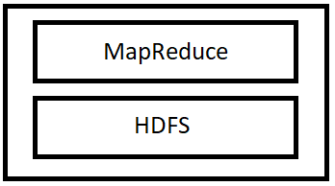
What is Hadoop?
An open-source framework.
MapReduce utilize to process data
HDFS is a file system that divide and store data in different computers.

Slide 4
Key attributes
Massive storage space
Low cost
Computing power
Scalability
Flexibility
Failure tolerance

Slide 5
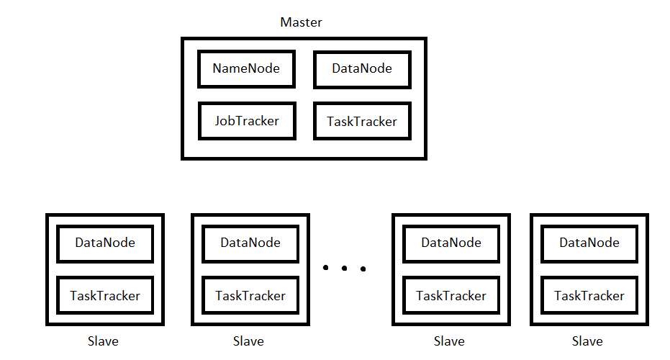
Hadoop cluster

Slide 6
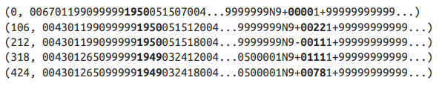
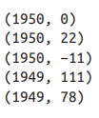
MapReduce mechanism
Two main phases: Map and Reduce
Input to Map:
Output of Map:

